Slide 1
Introduction to Data Analysis

Slide 2
DATA COLLECTION & DATA MANAGEMENT
Patrick Boily Data Action Lab | uOttawa | Idlewyld Analytics
pboily@uottawa.ca
[with files from Jen Schellinck | Sysabee]

Slide 3

OBJECTIVE
We seek data that can:
provide legitimate insight into our system of interest;
provide correct, accurate answers to relevant questions;
support the drawing of valid conclusions, with the ability to qualify/quantify these conclusions in terms of scope and precision.
This cannot be done without study design: what data should we collect, and how should we collect it.

Slide 4

MOTIVATIONS FOR DATA COLLECTION
Three functions, historically:
record keeping (people/societal management)
science – new general knowledge
intelligence – business, military? police? social? domestic? personal?
Each of these three functions have traditionally used different sources of information.
they have collected different types of data
they also have different data cultures and terminologies

Slide 5

DATA IS REAL
Data is a representation, but data is still physical.
It has physical properties, it requires physical space & energy to work with it.

Slide 6

DATA DECAYS
Data ages over time – it has a shelf life.
We use the phrase “rotten data” or “decaying data”
literally – the data storage medium might decay
metaphorically – when the data no longer accurately represents the relevant objects and relationships or even when those objects no longer exist in the same way
Data must be kept ‘fresh’ and ‘current’, not ‘stale’ (context and model dependent!)

Slide 7
NPS AND PATTERN FISHING
Two separate issues can be combined to cause problems with data analysis:
drawing conclusions (inferences) from a sample about a population that are not warranted by the sample collection method (symptomatic of NPS);
looking for any available patterns in the data and then coming up with post hoc explanations for these patterns.
Alone or in combination, these lead to poor (and potentially harmful) conclusions.

Slide 8
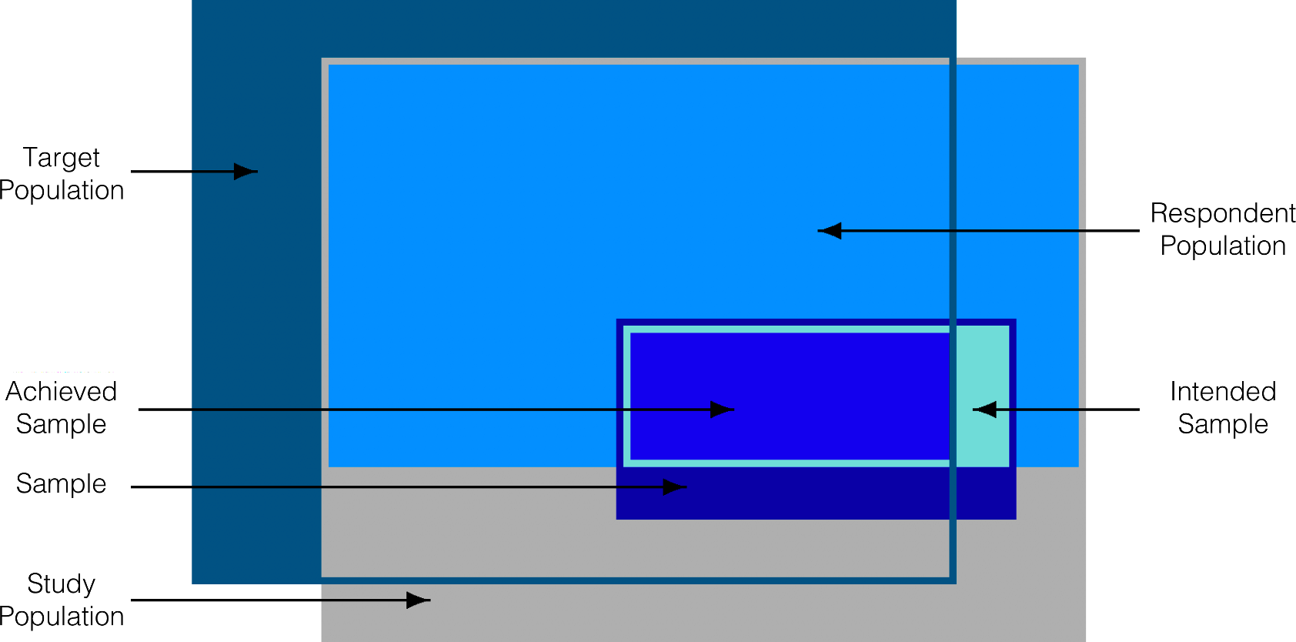
Target Population
RespondentPopulation
Achieved Population
Intended Sample
Sample
Study Population

Slide 9
STUDY/SURVEY STEPS
Surveys follow the same general steps:
statement of objective
selection of survey frame
sampling design
questionnaire design
data collection
data capture and coding
data processing and imputation
estimation
data analysis
dissemination
documentation
The process is not always linear, but there is a definite movement from objective to dissemination.

Slide 10
NON-PROBABILISTIC SAMPLING
Nonprobabilistic sampling (NPS) methods (designs) select sampling units from the target population using subjective, non-random approaches.
NPS are quick, relatively inexpensive and convenient (no frame required).
NPS methods are ideal for exploratory analysis and survey development.
Unfortunately, NPS are often used instead of probabilistic designs (not good)
the associated selection bias makes NPS methods inferentially unsound;
automated data collection often fall squarely in the NPS camp – we can analyze data collected with a NPS approach, but not generalize the results to the target population.

Slide 11
PROBABILISTIC SAMPLING
Probabilistic sample designs are usually more difficult and expensive to set-up (due to the need for a quality frame), and take longer to complete.
They provide reliable estimates for the attribute of interest and the sampling error, paving the way for small samples being used to draw inferences about larger target populations (in theory, at least; the non-sampling error components can still affect results and generalisation).

Slide 12
SAMPLING DESIGNS
Different sampling designs have distinct advantages and disadvantages.
They can be used to compute estimates
for various population attributes: mean, total, proportion, ratio, difference, etc.
for the corresponding 95% confidence intervals.
We might also want to compute sample sizes for a given error bound (an upper limit on the radius of the desired 95% CI), and how to determine the sample allocation (how many units to be sampled in various sub-population groups).

Slide 13
PROBABILISTIC SAMPLING DESIGNS
Simple random sampling (SRS)
Stratified random sampling (STS)
Systematic sampling (SYS)
Cluster sampling (CLS)
Probability proportional-to-size sampling (PPS)
Replicated sampling (RES)
Multi-stage sampling (MSS)
Multi-phase sampling (MPS)

Slide 14
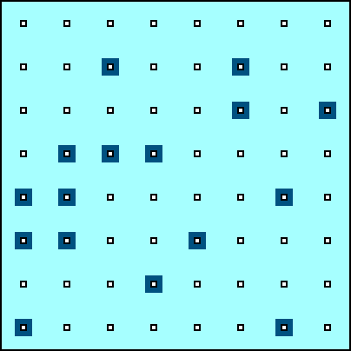
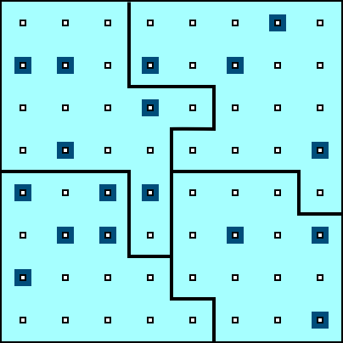
SAMPLING DESIGNS
Simple Random Sampling (SRS)
Stratified random sampling (STS)

Slide 15
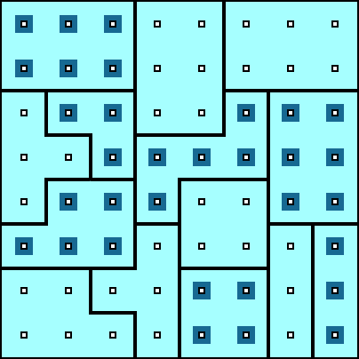
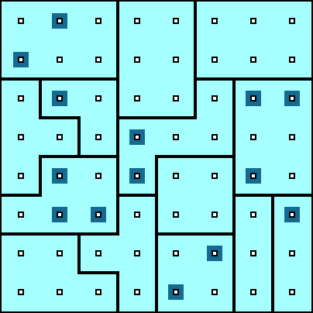
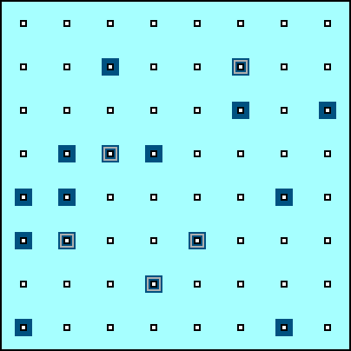
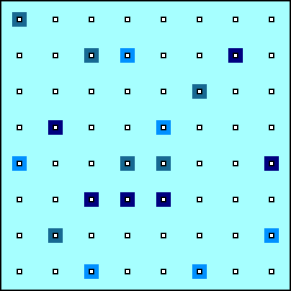
OTHER SAMPLING DESIGNS
Cluster Sampling (ClS)
Multi-Stage Sampling (MSS)
Multi-Phase Sampling (MPS)
Replicated Sampling (ReS)

Slide 16
AUTOMATED DATA COLLECTION CHECKLIST
With regards to social scientific data:
sparse financial resources
little time or desire to collect data by hand
want to work with up to date, high-quality data sources
document process from data collection to publication for reproducibility
Issues with manual collection:
non-reproducible process
prone to errors and cumbersome
subject to heightened risks of “death by boredom”
Advantages:
reliability
reproducibility
time-efficient
higher quality datasets

Slide 17
WEB SCRAPING DATA QUALITY
First-hand information: for example, a tweet, or a news article.
Second-hand data: data that has been copied from an offline source or scraped from elsewhere.
Sometimes one can’t remember or retrace the source of such data.
Does it still make sense to use it? It depends.
Any use of secondary data requires cross-checking and validation.

Slide 18
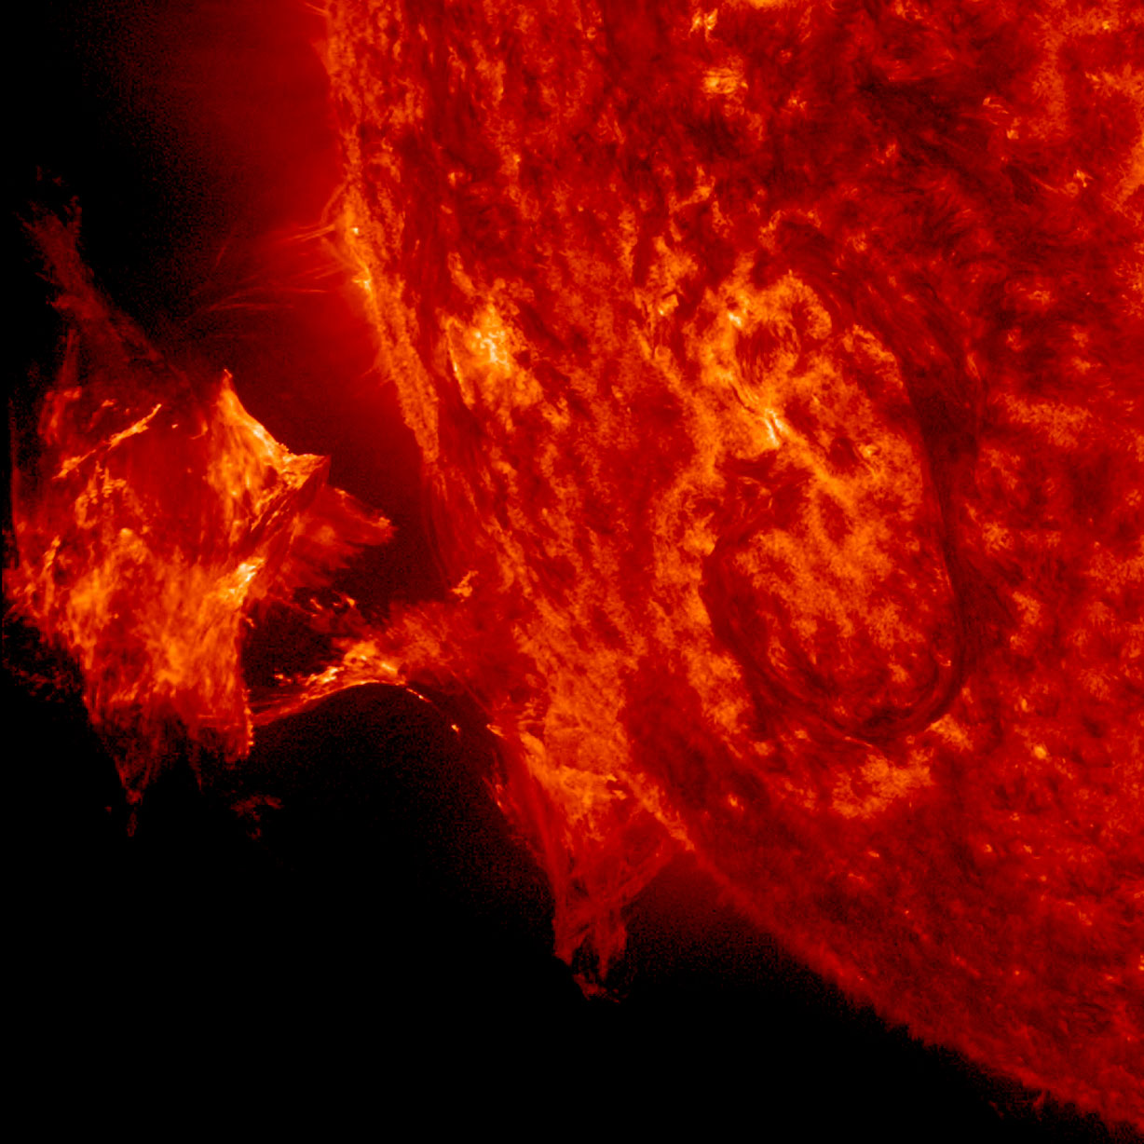
STRUCTURED/UNSTRUCTURED DATA
A major motivator for new developments in database types and other data storing strategies is the increasing availability of unstructured data and 'blob' data:
structured data: labeled, organized, discrete structure is constrained and pre-defined
unstructured data: not organized, no specific pre-defined structure data model (text)
blob data: Binary Large Object (BLOb) – images, audio, multi-media

Slide 19
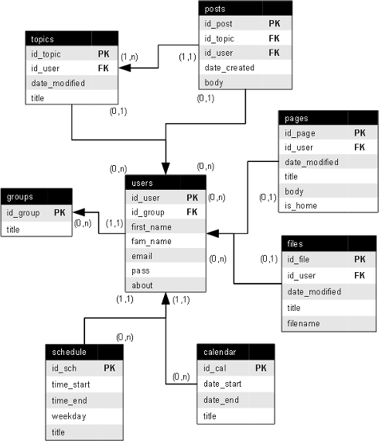
RELATIONAL DATABASES
Data is stored in a series of tables.
Broadly speaking, each table represents an object and some properties related to this object.
Special columns in the tables connect object instances across tables (allowing for merges).
The traditional approach to data storage.

Slide 20
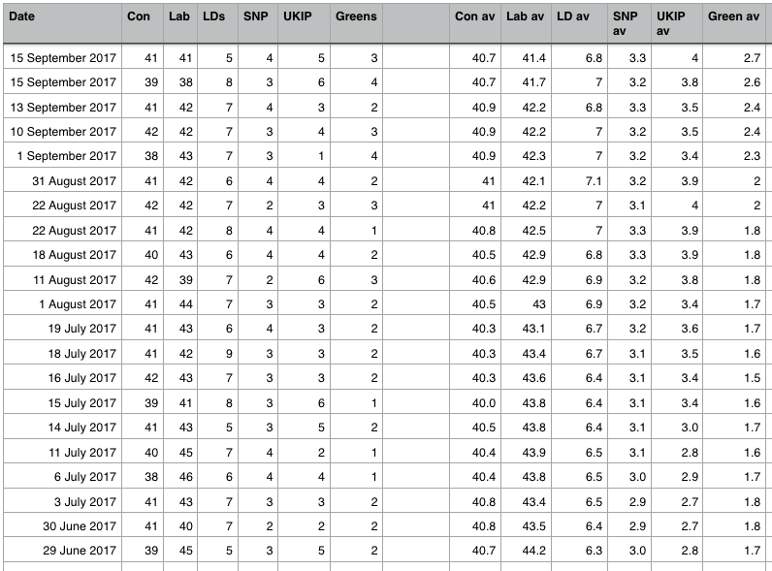
FLAT FILES AND SPREADSHEETS
What about keeping data in a single giant table (spreadsheet)?
Or multiple spreadsheets?
How bad can it be?
Wayne Eckerson coined the term ‘spreadmart’ to describe a situation with many (ad hoc) spreadsheets as a data strategy.

